Slide 1
Ivy’s parts
User registration: Users fill in personal information (name, phone, email, ID number) to register an account.
Remove user: The user logs out the account and no longer uses the system. Clear database personal information.
Login: The user logs in to the program by using the registered account password.
Notes:
I am responsible for three use cases, use cases 1,2,3
These three use cases are common in our daily life when we use some software or application.
The three use case is user registration, remove user and login.

Slide 2
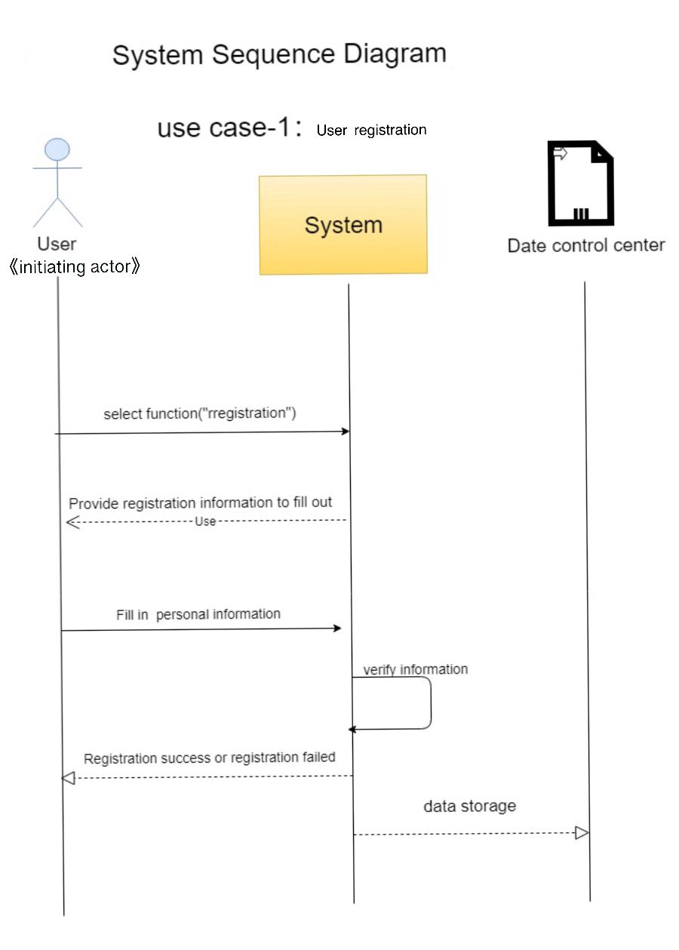
UC-1: User registration
Use Case UC-1:User Registration
Related Requirements: REQ-1:Users need to register accounts. REQ-3:Users need account passwords to log in. Initiating Actor: User Actor’s Goal: To create a new user account and allow the use of self-contained cabinets Participating Actors: User, Data Processing Center Preconditions: The system displays the menu of available functions. At the application the menu choice is Registration. Flow of Events for Main Success Scenario: ----->User opens the application and selects the menu item ”Registration”. include::User registration(UC-1), Data processing(UC-5) <-----a: system provide registration information order to fill out ----->b: the user fill in the personal information <-----c: system verify the account <-----d: system send the registration success or not to user e:data storage----->
Notes:
When we start a new application, the first step is to have an account of our own.
So The first ues cases is user registration.
Users need to fill in personal information(name, phone, email, ID number) to register an account.
Preconditions: The system displays the menu of available functions. Users choose to registration from the options provided by the application
First, Users send requests to registration. The system receives the request and provide registration information to fill out.
Then, users fill in personal information, The system verifies personal information. If the information is correct, it returns "successful registration" or "failed registration".
After successful registration, the data processing center stores information.

Slide 3
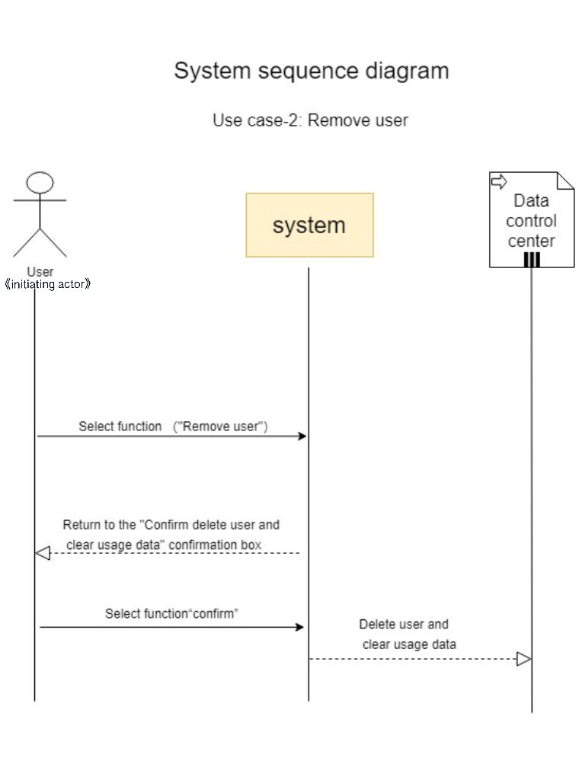
UC-2: delete user.
Use Case UC-2：Remove User
Related Requirements: REQ-2: Users need to cancel their accounts. Initiating Actor: User Actor’s Goal: Delete user accounts and clear user data Participating Actors: User, Data Processing Center Preconditions: The system displays the menu of available functions. At the application the menu choice is Remove Flow of Events for Main Success Scenario: ----->User opens the application and selects the menu item ”Remove”. include::Remove user(UC-2) <-----a:The system prompts the user to confirm whether to clear the user information ----->b:The user confirms to clear personal data from the database <-----c:system verify the account <-----d:The system sends a clear success message to the user e：Data to remove----->
Notes:
When a user decides not to use the application anymore, he may need to delete his account, which not only deletes personal information,
but also saves the memory of the system database.
So We need UC2 remove user to delete the account.
Preconditions: The system displays the menu of available functions. Users choose to delete accounts from the options provided by the application
First, Users send requests to remove users. The system receives the request and return to the “confirm delete user and clear usage data ”confirmation box.
Then, users select function “confirm” or “exit”, if system receives “confirm”, it will delete user and clear usage data on Data control center.

Slide 4
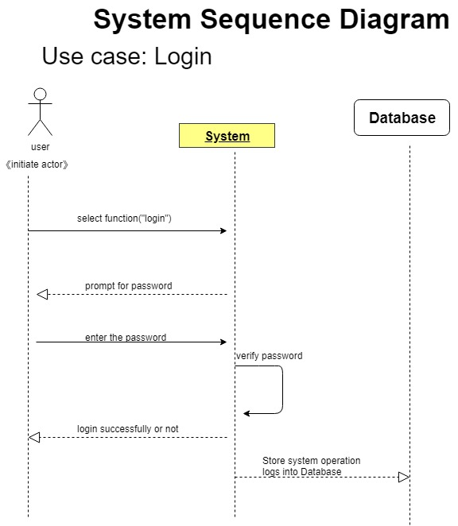
UC-3: Login
UC-3: Login: Users log in with registered account passwords.
Related Requirement’s: REQ3:Users need account passwords to log in. Initiating Actor: All registered users Actor’s Goal: Log in to use the application Participating Actors: user, Data Processing Center Preconditions: User enters login account and password, click login. Post conditions: achieve the process of what the users want to get. Flow of Events for Main Success Scenario: Users enter the login page and enter their account number and password for login.
Notes:
When we have registered our account, we need to log in to continue accessing the application.
So the third is login, The user logs in to the program by using the registered account password.
First, Users select function ”login” . The system receives requests and provides input boxes for username and password
Then, users fill in username and password, The system verifies personal information. If the information is correct, it returns "successful login" or "ERROR Incorrect username or password".
After successful login, the data processing center stores system operation logs into database.

Slide 5
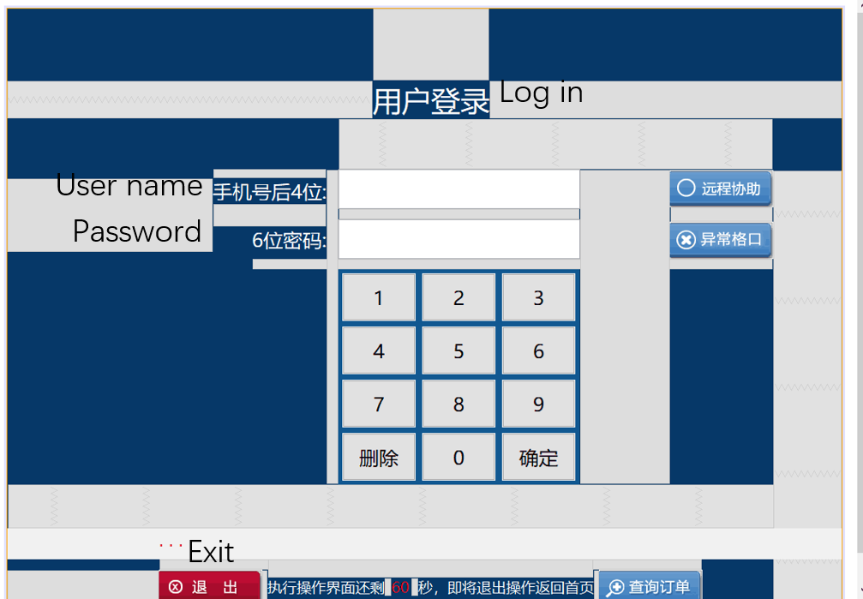
Use case code demonstration
void ClearData() {
m_blNextClick = false;
m_CurTabIndex = "1";
m_Curtxt = txtDelieverPhone;
txtDelieverPhone.Clear();
txtDelieverPwd.Clear();
lblTipMsg.setText("...");
CBaseEnum.SetButtonStatus(btnExit, btnPreStep, 3);
}
void VoiceTip() {
CCommondFunc.VoiceTip("请输入投递员登录信息-Please enter the sender login information");
}
void SetTextBox() {
txtDelieverPhone.SetTextBox(1, 11);
txtDelieverPwd.SetTextBox(2, 4);
txtDelieverPhone.setFocusable(true);
}

Slide 6
Use case code demonstration
public void PacketInput_KDYRZ(String err) {
if (!"".equals(err)) {
m_blNextClick = false;
lblTipMsg.setText("认证失败-Authentication failed:" + err);// 错误输出
CBaseEnum.SetButtonStatus(btnExit, btnPreStep, 3);
}
}
boolean DelieverPhone_Validated() {
return CCommondFunc.Phone_Validated(txtDelieverPhone.GetText(), lblTipMsg, "手机号-phone number");
}
boolean DelieverPwd_Validated() {
String pwd = txtDelieverPwd.GetText();
if ("".equals(pwd)) {
lblTipMsg.setText("4位校验码不能为空，请重新输入！-4-bit check code can not be empty, please re-enter!");
return false;
}
else {
if (4 != pwd.length()) {
lblTipMsg.setText("4位校验码格式不正确，请重新输入！4-bit check code format is incorrect, please re-enter!");
return false;
}
}
lblTipMsg.setText("...");
return true;
}
boolean DelieverPwd_Compare() {
if (!txtDelieverPwd.GetText().equals(CCommondFunc.GetCheckPhone(txtDelieverPhone.GetText()))) {
lblTipMsg.setText("4位校验码校验失败，请重新输入！-4-bit check code failed, please re-enter!");
return false;
}
lblTipMsg.setText("...");
return true;
}

